Slide 1

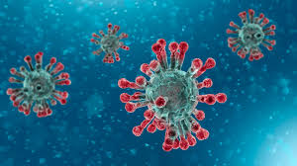
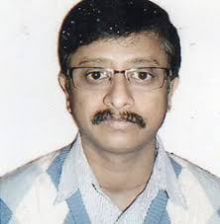
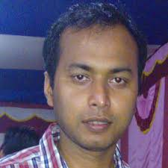

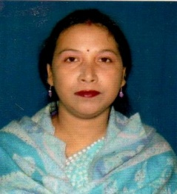
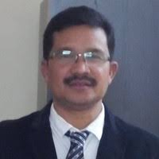
DHSK COLLEGE
DIBRUGARH
DEPARTMENT OF PHYSICS
TWO DAY WEBINAR
ON EFFECTS OF COVID-19
PANDEMIC ON HEALTH AND WELL BEING OF STUDENTS
RESOURCE PERSONS
Dr. Intikabur Rahman, MD
Medicine Specialist
Aditya Diagnostics & Hospital ,Dibrugarh
Dr. Dhrubajyoti Bhuyan
Assistant Professor,
Dept. of Psychiatry,
Assam Medical College, Dibrugarh
INAUGURATOR
CO-ORDINATORS
Dr. Sashi Kanta Saikia
Principal,
DHSK College
Ms. Tribeni Saikia
HOD, Dept. of Physics
DHSK College
LIVE WEBINAR
AT GOOGLE MEET
DATE : 2nd & 3rd August, 2020
TIME : 11 AM
Dr. Ranjan Changmai
Assistant Professor
Dept. of Physics,
DHSK College
E-CERTIFICATES WILL BE PROVIDED TO ALL ACTIVE PARTICIPANTS

Slide 2

TWO DAY WEBINAR
ON EFFECTS OF COVID-19
PANDEMIC ON HEALTH AND WELL BEING OF STUDENTS
DHSK COLLEGE
DIBRUGARH
DEPARTMENT OF PHYSICS
Programme Details
02-08-2020
Welcome address
Inaugural Speech by Dr.S.K.Saikia,
Principal,DHSK College
Talk on Covid19: its importance and prevention
By Dr.I.K.Rahman
Interaction session
03-08-2020
Talk on Coping with Corona Crisis: Healthy mind for better future
by Dr.D.Bhuyan
Interaction session
Vote of thanks
    Organizing Committee
Mr.Aditya Dahal.
Assistant Professor,
Dept.of Physics
Dr.J.P.Phukan.
Assistant Professor,
Dept.of Physics
Mr.A.Borthakur
Assistant Professor,
Dept.of Physics
Dr.P.Chutia
Assistant Professor,
Dept.of Physics
Mr.Deepjyoti Baruah
Dept.of Physics

